Slide 1
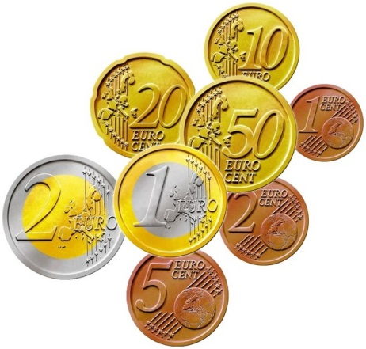
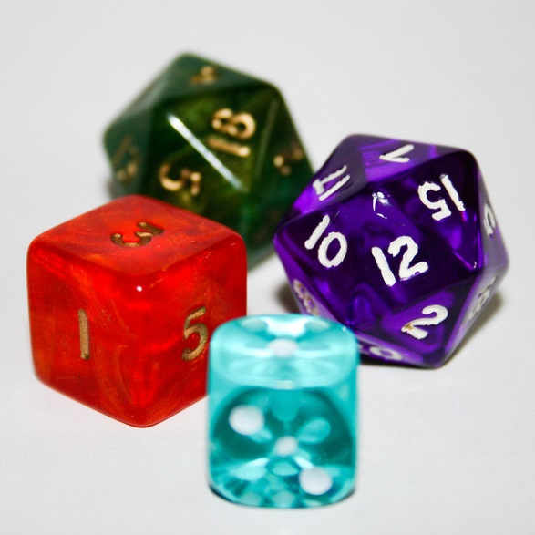

My Probability Interactive Notebook
Name
Class
Teacher
Term 4 Semester 2
1

Slide 2
Contents
Glossary or Formula Page
Page
Date
Description
2
3

Slide 3
Tasks
24
7
30
Essential Question
Questions
Notes
Summary
4
5

Slide 4
24
7
30
Date
Venn Diagrams
EQ – How can I put the information from a Venn diagram into a two-way table?
When the results of an experiment involve overlapping categories you can organise the information into a Venn diagram or two-way table.
These can then be used to calculate probabilities.
Example – Draw a Venn Diagram showing the number of students in the class with a brother or sister.
9

Slide 5
24
7
30
Date
Venn Diagrams
EQ – How can I put the information from a Venn diagram into a two-way table?
In a class of 34 Mathematics students 18 do Food Science, 21 do Wood Technology and 5 do neither. Put this information on the Venn diagram below and find the probability of a student doing both Food and Wood.
9

Slide 6
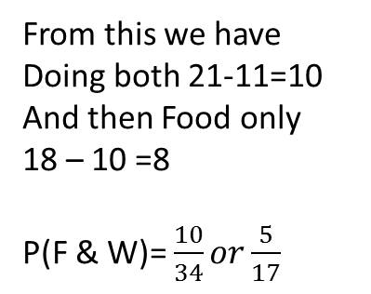
24
7
30
Date
Venn Diagrams
EQ – How can I put the information from a Venn diagram into a two-way table?
In a class of 34 Mathematics students 18 do Food Science, 21 do Wood Technology and 5 do neither. Put this information on the Venn diagram below and find the probability of a student doing both Food and Wood.
There are 34-5=29 students doing F, W or both
Therefore those doing Wood alone will be 29-18=11
34
From this we have
Doing both 21-11=10
And then Food only
18 – 10 =8
P(F & W)= $\frac{10}{34}or\frac{5}{17}$
W-21
F-18
8
10
11
5
9

Slide 7
Notes Review
24, 7 ,30
Date
Title
Essential question
Notes complete
Notes complete with colour and diagrams
Questions completed
Contents page filed in
Formula page filled in

Slide 8
Homework
Review your notes and write a summary answering the essential question.

